Slide 1
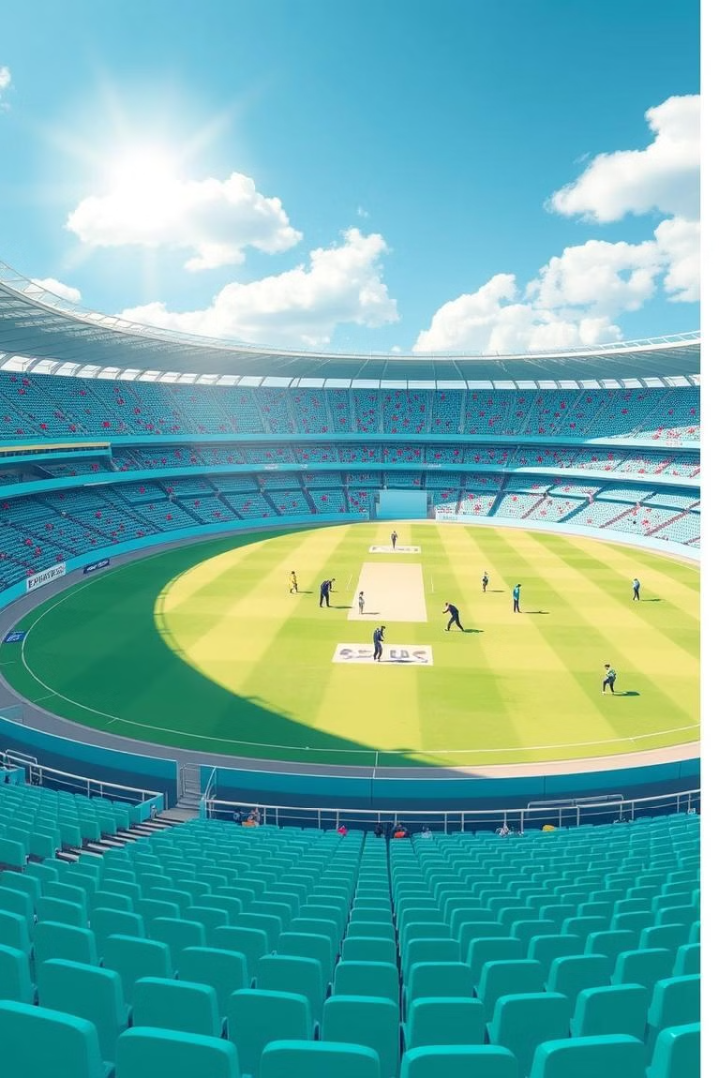
Machine Learning lab Project
Title:-Cricket Score Predictor
By-
K.Shivanand-160122737110
K.Koushik-160122737112
v.Sricharan-160122737131

Slide 2
Cricket Score Prediction
Predicting cricket scores is a complex task that requires analyzing various factors such as team performances, player statistics, and match conditions. This presentation will explore a data-driven approach to forecasting cricket scores using machine learning models.

Slide 3

Data Preprocessing
1
Input Parameters
2
Data Cleansing
Handling missing values, outliers, and inconsistencies in the input data.
Batting team, bowling team, current over, present runs, last 5 overs' wickets and runs.
3
Feature Engineering
Deriving new relevant features from the raw data to enhance the predictive power.

Slide 4
Machine Learning Models
Decision Tree
Linear Regression
Random Forest
A tree-based model that makes predictions based on a series of decisions.
A linear model that predicts the target variable as a linear function of the input features.
An ensemble model that combines multiple decision trees to improve accuracy and robustness.

Slide 5
Model Descriptions
XGBoost
KNN
Evaluation Metrics
A gradient boosting algorithm that combines multiple weak models to create a strong predictive model.
A non-parametric model that makes predictions based on the k nearest neighbors in the feature space.
Test Score,Mean Squared Error,Root Mean Squared Error,Mean Absolute Error

Slide 6

Best Model
Random Forest Regressor
Advantages
Interpretable, handles non-linear relationships, and can capture complex interactions in the data.
The Random Forest Regressor model achieved the highest test score of 80% on the test data.
Limitations
Next Steps
Prone to overfitting and may not generalize well to new, unseen data.
Further optimization and ensemble techniques to improve the model's performance.

Slide 7

Model Comparison and Evaluation
Model Comparison
Cross-Validation
Evaluate the performance of different machine learning models using various metrics.
Ensure the models generalize well to unseen data by using robust validation techniques.
1
2
3
Hyperparameter Tuning
Optimize the hyperparameters of the models to improve their predictive accuracy.

Slide 8

Conclusion and Recommendations
1
Key Findings
2
Future Improvements
The Random Forest Regressor model achieved the best performance in predicting cricket scores.
Explore ensemble methods and incorporate additional data sources to enhance the model's accuracy.
3
Real-World Applications
The trained model can be deployed to provide real-time score predictions during cricket matches.

Slide 9
Random Forest Regressor: Powering Accurate Cricket Score Predictions
Decision Tree Ensemble
1
Random Forest Regressor is an ensemble learning method that combines multiple decision trees to enhance predictive accuracy.
2
Feature Importance
The model automatically identifies the most relevant features, allowing it to focus on the key drivers of cricket scores.
Robust to Overfitting
3
By averaging the predictions of multiple decision trees, Random Forest Regressor reduces the risk of overfitting and improves generalization.

Slide 10

Appendix
Model
Test Score
Mean Absolute error
Root Mean Squared Error
Linear Regression
65%
8
15
Decision Tree
65%
7
17
Random Forest
80%
7
13
XGBoost
70%
11
16
KNN
65%
12
17

Slide 11
Random Forest Regressor: The Winning Approach for Cricket Score Prediction
The Random Forest Regressor has proven to be a powerful machine learning model for accurate cricket score prediction. By leveraging an ensemble of decision trees, the model can capture complex non-linear relationships in the data and provide robust, reliable predictions. Its ability to automatically identify the most relevant features ensures the model focuses on the key drivers of cricket scores, leading to its superior performance compared to other techniques.
Going forward, further optimizing the Random Forest Regressor through techniques like hyperparameter tuning and ensemble methods can unlock even greater predictive accuracy. Integrating this model into real-world applications can empower fans, teams, and analysts with the ability to forecast match outcomes with unprecedented precision, revolutionizing the way cricket is experienced and analyzed.

Slide 12
Thank You!

